Slide 1
INFORMATION PRESENTATION
Practices and TEST RUN
WELCOME TO ICEDERBY
- Too good an opportinity for the entire skating world to not get started -
Europe B.V.
Thursday evening
Februari 6th 2020
Thialf Restaurant
Heerenveen, NED
TEST RUN
SUNDAY
9th of February 2020
HEERENVEEN, NED
THIALF

Slide 2
Information Presentation
Practices and TEST RUN
Chairman: Jack Mortell
Vice-Chairman: Dennis Klaster
Test Run Manager: Rick Schipper
Honorary Chairman: Do Jung Hyun
Budgetkeeper: Susan Wells
Referees: Bert Timmerman/ Frank Zwitser
Starter: Jans Rosing
ET systems: Jeroen Fredriks/ETiming
Ice Floor Supervisor: Beert Boomsma
Medical Team: FASE, Kolham
Europe B.V.
TEST RUN
SUNDAY
9th of February 2020
HEERENVEEN, NED
THIALF

Slide 3
Information Presentation
Information Presentation
Practices and TEST RUN
Practices and TEST RUN
Thursday 6-feb
20:15 | Welcome in thialf In the business club (midfloor finishing straight. at the Icederby banners)
20:20 | Presentation Icederby
 | Info about trainingen and Test Run
20:30 | Start delicious dinner and questioning
20:45 | Make an inventory of material and sleeping places
20:45 | Checking skates and clothes
 | Mounting the material with help of experts. And also Sjinkie blocks assembling.
 | Other preparations
21:15 | To the infield for WU on shoe before skating
21:50 | On the track 220m
21:52 | Start training with RTC trainers Dave Versteeg, Leon Bloemhof. General repetition.
22:40 | End training
Europe B.V.
TEST RUN
SUNDAY
9th of February 2020
HEERENVEEN, NED
THIALF

Slide 4
Information Presentation
Information Presentation
Practices and TEST RUN
Practices and TEST RUN
Seriousness Test Run
Completely informing participants
No winning or losing:
- The track is safe
- Competitions with: Clap- and fixed skates.
- You can overtake
- The competition format works well
- The rules can be applied
Europe B.V.
TEST RUN
SUNDAY
9th of February 2020
HEERENVEEN, NED
THIALF

Slide 5
Information Presentation
Information Presentation
Practices and TEST RUN
Practices and TEST RUN
All Icederby and Test Run information is available on the website: http://www.ice1.global/testrun
Europe B.V.
TEST RUN
SUNDAY
9th of February 2020
HEERENVEEN, NED
THIALF

Slide 6
Information Presentation
Information Presentation
Practices and TEST RUN
Practices and TEST RUN
Europe B.V.
TEST RUN
SUNDAY
9th of February 2020
HEERENVEEN, NED
THIALF

Slide 7
Information Presentation
Information Presentation
Practices and TEST RUN
Practices and TEST RUN
Harmonized ISU Rules
Rules Mass Start
Shorttrack Start
Flying 1 Lap Start procedure
Conduct of races
Europe B.V.
TEST RUN
SUNDAY
9th of February 2020
HEERENVEEN, NED
THIALF

Slide 8
Information Presentation
Information Presentation
Practices and TEST RUN
Practices and TEST RUN
Harmonized ISU Rules
Further explanation rules
Shorttrack Start will be trained in practice
Overtaking is not allowed in neutral lap
Neutral lap does not count as first lap
No final rounds
Crossing the corner innerline is DQ
Flylap: 1 skater at the time
Starter organizes the skaters
Europe B.V.
TEST RUN
SUNDAY
9th of February 2020
HEERENVEEN, NED
THIALF

Slide 9
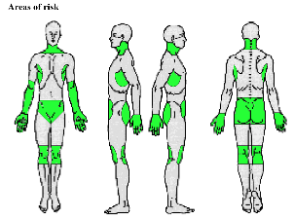
Information Presentation
Information Presentation
Practices and TEST RUN
Practices and TEST RUN
Safety requirements Mass start norm:
A helmet: to ISU norms ASTM norm F1849
Cutproof: gloves, shins and ankle
Closed clothing with long sleeves and legs.
Cut-resistant racing suit or underwear (see below)
Tubes of the skates must be closed.
Blade and the blade ends must be rounded (round 10 cents coin).
The blades has to be closed and the ends has to be rounded with minimal 10cent coin
Wearing eye protection, a cut-resistant suit or cut-resistant underwear is NOT mandatory but is recommended.
Please, put on glasses!
Europe B.V.
TEST RUN
SUNDAY
9th of February 2020
HEERENVEEN, NED
THIALF

Slide 10
Information Presentation
Information Presentation
Practices and TEST RUN
Practices and TEST RUN
Ethics and Media
Ethical aspects of research
fully inform
written permission
debriefing
confidentiality
Restrictions according to Test Run
No media activation
No Social Media
Our Special Media party
SBC Media
Europe B.V.
TEST RUN
SUNDAY
9th of February 2020
HEERENVEEN, NED
THIALF

Slide 11
Information Presentation
Information Presentation
Practices and TEST RUN
Practices and TEST RUN
Ethics and Media
Ethics with compliance to the ISU Rules
Incl. codes of conduct prescribed by
the ISU Council.
ISU Code of Ethics 2018
Ethical rules by the IOC
Europe B.V.
TEST RUN
SUNDAY
9th of February 2020
HEERENVEEN, NED
THIALF

Slide 12
Information Presentation
Information Presentation
Practices and TEST RUN
Practices and TEST RUN
Safety scenario
ISU medical requirements
Boarding Sidijk
FASE Scenario
Ice preparation
Europe B.V.
TEST RUN
SUNDAY
9th of February 2020
HEERENVEEN, NED
THIALF

Slide 13
Information Presentation
Information Presentation
Practices and TEST RUN
Practices and TEST RUN
More safety arrangements:
Declaration for adjusting the material to Icederby sizes
Sjinkie Knegt Transfer Blocks
Invited material experts
Improved boarding set-up
Offer of two practices Icederby
(Friday 10h15-11h30)
Europe B.V.
SUNDAY
9th of February 2020
HEERENVEEN, NED
THIALF

Slide 14
Information Presentation
Information Presentation
Practices and TEST RUN
Practices and TEST RUN
Sunday 9th February
11:00 | Thialf entry Icederby desk opened
11:00 - 16:15 | Catering for sporters, referee, members
11:00 - 12:15 | Transponder pick-up and material/ safety check
12:15 | Info meeting infield, skaters, referee, members
12:45 - 13:15 | Warm-up
13:15 - 16:11 | All the races.
16:30 - 19:00 | Finishing off: Buffet, speach, afterparty
Europe B.V.

Slide 15
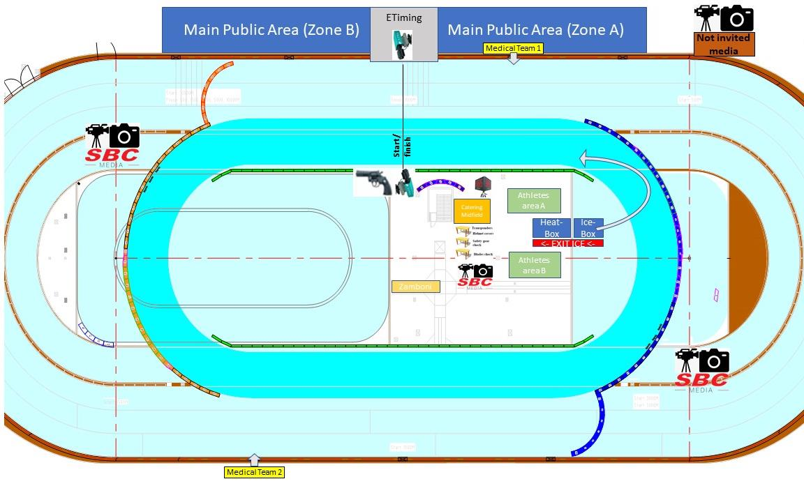

Slide 16
Information Presentation
Information Presentation
Practices and TEST RUN
Practices and TEST RUN
Useful for Inline boots and Shorttrack boots to a clap system.
Only for blades from Maple or Evo. Viking is not able to mount.
Europe B.V.
TEST RUN
SUNDAY
9th of February 2020
HEERENVEEN, NED
THIALF

Slide 17
Information Presentation
Information Presentation
Practices and TEST RUN
Practices and TEST RUN
General information Test Run:
Sunday 9th of February
Access to locations:
sporters: Blue-striped wristband
Referee, Starter volunteers or members: Green wristband
Guests for on the grandstand: No wristband.
Catering:
1st half: sandwiches, fruits, warm drinks
2nd half: Soop and pasta with salad
16h30: Afterparty with Chinese Buffet.
Europe B.V.
TEST RUN
SUNDAY
9th of February 2020
HEERENVEEN, NED
THIALF

Slide 18
INFORMATION PRESENTATION
Practices and TEST RUN
WELCOME TO ICEDERBY
- Too good an opportinity for the entire skating world to not get started -
Dave will further explain the schedule of tonight.
Europe B.V.
Thursday evening
Februari 6th 2020
Thialf Restaurant
Heerenveen, NED
TEST RUN
SUNDAY
9th of February 2020
HEERENVEEN, NED
THIALF

